Slide 1
ME 203 Introduction to MATLAB
1

Slide 2
Switch Case
The syntax in Matlab is
switch input expression (scalar or string)
case value 1
commands
case {value 2, value 3}
commands
·
·
·
otherwise
commands
end

Slide 3
Switch and Case
Used when a series of programming path options exist for a given variable depending on its value
Similar to the if/else/elseif
Allows you to choose between multiple outcomes based on a criterion
Criterion can be a scalar or string
The advantage of the switch structure is that in some situations, it yields code that is more readable

Slide 4
Switch Case
Switch variable
Case option1
code to be executed if variable is = to option 1
Case option2
code to be executed if variable is = to option 2
Case option_n
code to be executed if variable is = to option n
otherwise
code to be executed if variable is not = to any of the options
end

Slide 5
Switch Case Example 1
% example - unit conversion
x = 6.1; % meters
to_units = 'mm';% convert to
switch to_units
case {'meters','m'}
y = x
case {'centimeters','cm'}
y = x*100
case {'millimeters','mm'}
y = x*1000
case {'inches','in'}
y = x*39.3701
otherwise
disp (['Unknown units: ' to_units])
y = NaN
end
to_units = ‘inches';% convert to

Slide 6
Switch Case Example 2
clc; clear all; format compact
x = [12, 64, 24];
plottype = 'bar';
switch plottype
case 'bar'
bar(x)
title('Bar graph')
case {'pie','pie3'}
pie3(x)
title('Pie chart')
legend('First','Second','Third')
otherwise
warning('Unexpected plot type. No plot created')
end

Slide 7
Switch Case Example 3
Write a switch statement to assign RPM based on setting number
setting = 1;
switch setting
case 1
RPM = 1000;
case 2
RPM = 2000;
case 3
RPM = 3000;
otherwise
disp ('Unknown setting’)
RPM = 0;
end
setting | RPM
1 | 1000
2 | 2000
3 | 3000
No match | 0

Slide 8
Switch and Case
Case cannot include relational operators (such as < or >) for comparison against the switch input expression
MATLAB executes only one case of any switch statement
Variables defined within one case are not available for other cases
Define all variables necessary for code in a particular case within that case

Slide 9
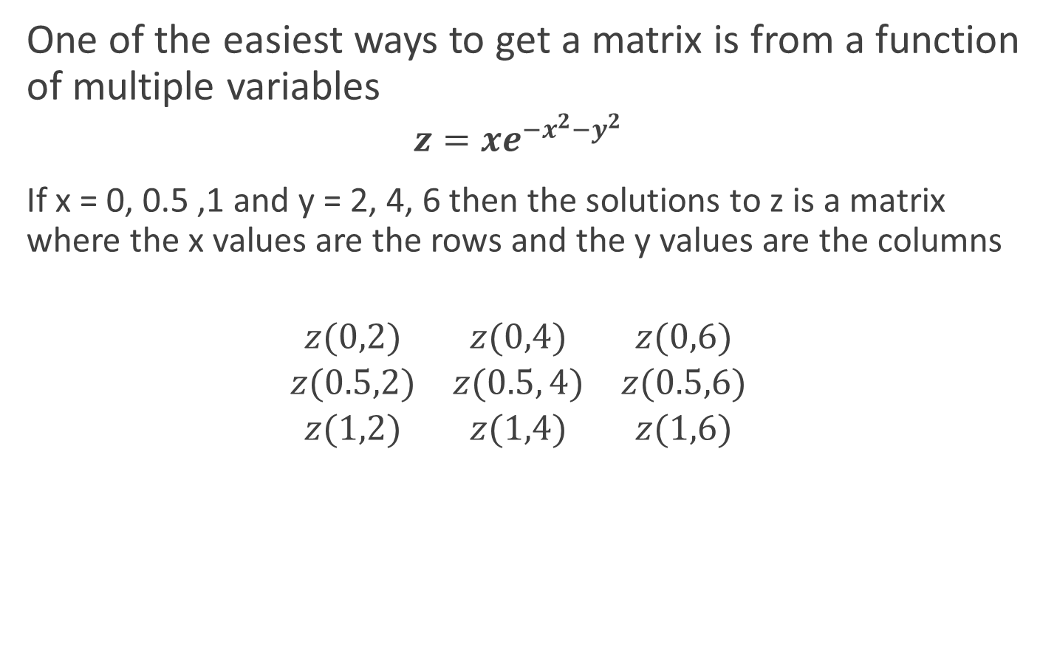
Matrix from functions
One of the easiest ways to get a matrix is from a function of multiple variables
$$z=xe^{−x^{2}−y^{2}}$$
If x = 0, 0.5 ,1 and y = 2, 4, 6 then the solutions to z is a matrix where the x values are the rows and the y values are the columns
$$\begin{matrix}z(0,2) & z(0,4) & z(0,6) \\ z(0.5,2) & z(0.5, 4) & z(0.5,6) \\ z(1,2) & z(1,4) & z(1,6)\end{matrix}$$

Slide 10

Ex: Create the following matrix in Matlab
$$z=xe^{−x^{2}−y^{2}}$$
where x = 0, 0.5 ,1 and y = 2, 4, 6
%Matrix Example
clc; clear all; format compact
%Given
x=0:0.5:1;
y=2:2:6;
z=zeros(length(x),length(y));
for i=1:length(x)
for j=1:length(y)
z(i,j)=x(i)*exp(-x(i)^2-y(j)^2);
end
end
z

Slide 11
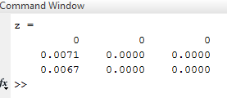
Ex: Create the following matrix in Matlab
Result

Slide 12
Ex: Create the following matrix in Matlab
$$z=xe^{−x^{2}−y^{2}}$$
where x = 0, 0.5 ,1 and y = 2, 4, 6
%Matrix Example
clc; clear all; format compact
%Given
x=0:0.5:1;
y=2:2:6;
z=zeros(length(x),length(y));
for i=1:length(x)
for j=1:length(y)
z(i,j)=x(i)*exp(-x(i)^2-y(j)^2);
end
end
format longeng %engineering format
z

Slide 13
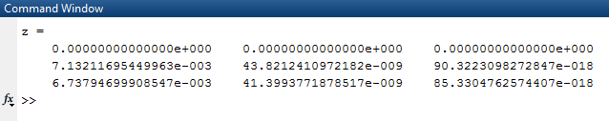
Ex: Create the following matrix in Matlab
Result

Slide 14
Plotting matrices - Contour
contour(X,Y,Z)
The x, y and z are all matrices

Slide 15
Plotting matrices - Quiver
quiver(X,Y,DX,DY)
The x and y positions as well as the velocity in the x and y directions are all matrices

Slide 16
Plotting matrices - Surf
surf(x,y,z)
Surf can either be shown in 2D or 3D

Slide 17
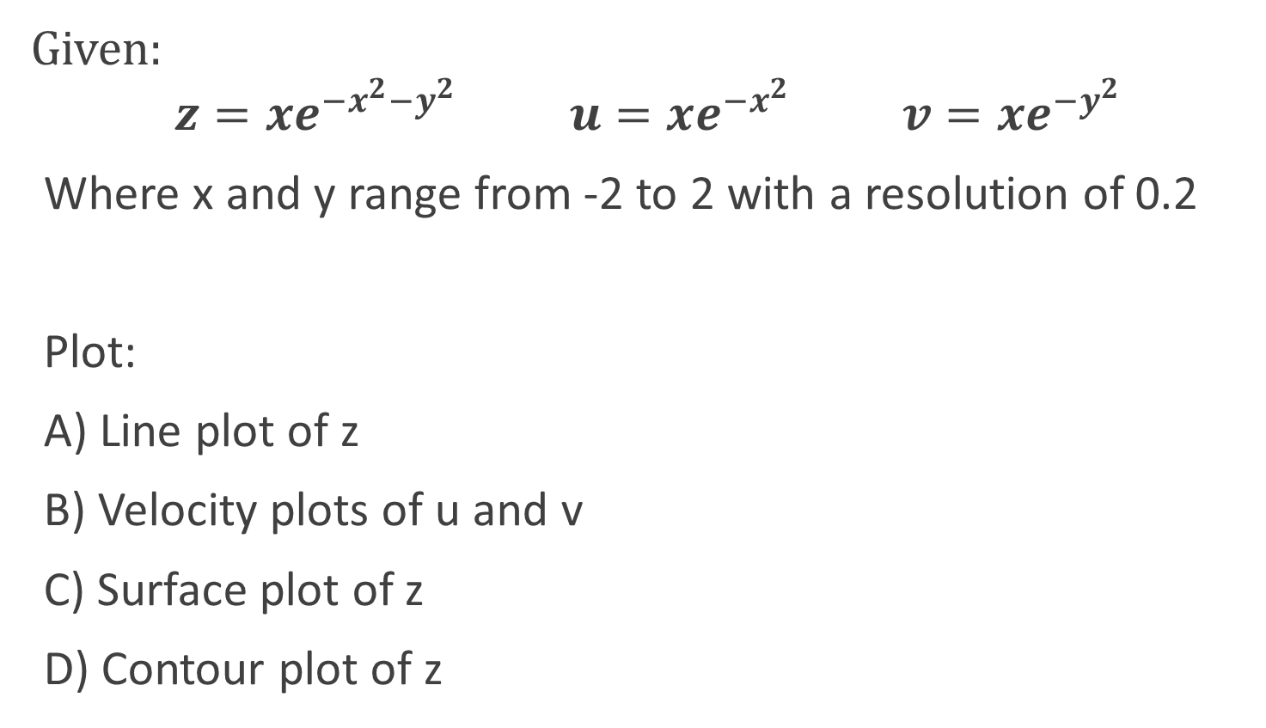
Example
Given:
$$z=xe^{−x^{2}−y^{2}} u=xe^{−x^{2}} v=xe^{−y^{2}}$$
Where x and y range from -2 to 2 with a resolution of 0.2
Plot:
A) Line plot of z
B) Velocity plots of u and v
C) Surface plot of z
D) Contour plot of z

Slide 18
Example – Part A
clc; clear all; format compact
%given
x=-2:0.2:2;
y=-2:0.2:2;
for i=1:length(x)
for j=1:length(y)
z(i,j)=x(i)*exp(-x(i)^2-y(j)^2);
end
end
%part a
figure(1)
plot3(x,y,z)
xlabel('x'), ylabel('y'), zlabel('z')

Slide 19
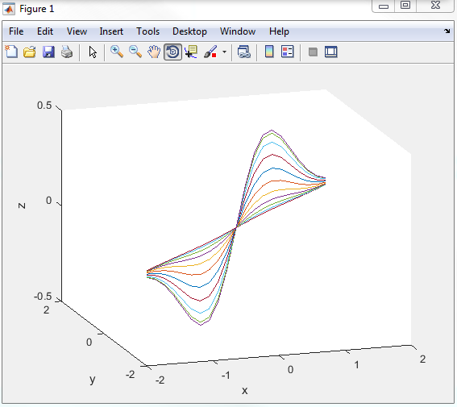
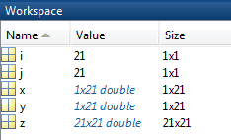
Example – Part A

Slide 20
Example – Part B
clc; clear all; format compact
%given
x=-2:0.2:2;
y=-2:0.2:2;
for i=1:length(x)
for j=1:length(y)
z(i,j)=x(i)*exp(-x(i)^2-y(j)^2);
u(i,j)=x(i)*exp(-x(i)^2);
v(i,j)=x(i)*exp(-y(j)^2);
end
end
%part b
figure(2)
quiver(x,y,u,v)
xlabel('x'), ylabel('y')

Slide 21
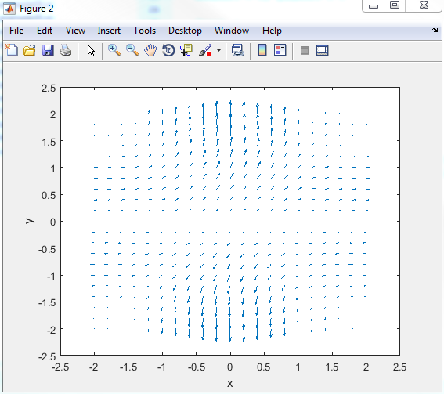
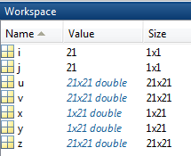
Example – Part B

Slide 22
Example – Part C
clc; clear all; format compact
%given
x=-2:0.2:2;
y=-2:0.2:2;
for i=1:length(x)
for j=1:length(y)
z(i,j)=x(i)*exp(-x(i)^2-y(j)^2);
end
end
%part c
figure(3)
surf(x,y,z)
xlabel('x'), ylabel('y'), zlabel('z')

Slide 23
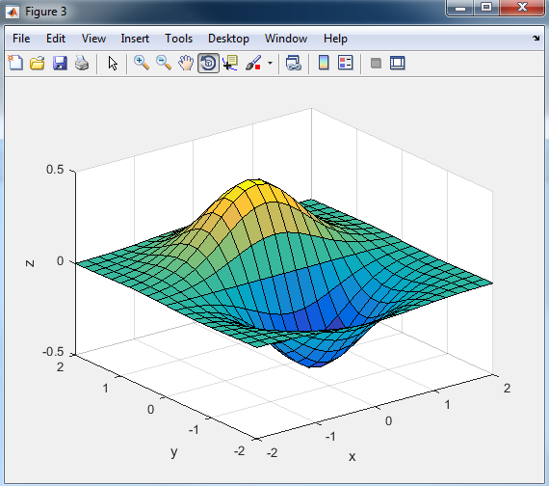
Example – Part C

Slide 24
Example – Part D
clc; clear all; format compact
%given
x=-2:0.2:2;
y=-2:0.2:2;
for i=1:length(x)
for j=1:length(y)
z(i,j)=x(i)*exp(-x(i)^2-y(j)^2);
end
end
%part d
figure(4)
contour(x,y,z)
xlabel('x'), ylabel('y'), zlabel('z')

Slide 25
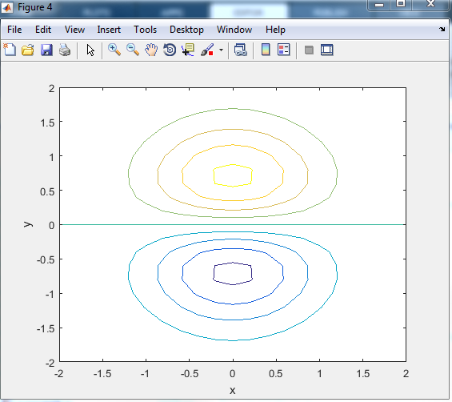
Example – Part D

Slide 26
Input function
The input function allows the user to specify a value or string and stores it in a variable
Input numerical values:
Input text/string:
variable_name = input('text to be displayed')
variable_name = input('text to be displayed','s')

Slide 27
Input function
Example:
>> X = input('Please enter the value of X: ')
Please enter the value of X: 2
X =
2
>> Day = input('Enter the day of the week: ', 's')
Enter the day of the week: Monday
Day =
Monday

Slide 28
Input function
Example: Input an array/matrix
>> arr1=input('Enter the elements of the vector: ')
Enter the elements of the vector: [1; 2; 3]
arr1 =
1
2
3
>> mat1=input('Enter the elements of the matrix: ')
Enter the matrix: [12, 1, 4; 34, 2, 7]
mat1 =
12 1 4
34 2 7

Slide 29
Input function
Example: Input elements of a matrix one by one
%Input matrix elements
clc; clear all; format compact
m=input('No of rows in the matrix: ');
n=input('No of columns in the matrix: ');
A=zeros(m,n);
fprintf('Enter the array elements\n')
for i=1:m
for j=1:n
A(i,j)=input('Enter value: ');
end
end
A

Slide 30
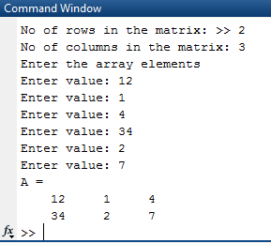
Input function
Example: Input elements of a matrix one by one

Slide 31
Input function
E.g. Use of input with switch case
Write a switch statement to assign RPM based on setting number. Accept setting as input.
clc; clear; format compact
setting = input('Enter the setting number: ');
switch setting
case 1
RPM = 1000
case 2
RPM = 2000
case 3
RPM = 3000
otherwise
disp ('Unknown setting')
RPM = 0
end
setting | RPM
1 | 1000
2 | 2000
3 | 3000
No match | 0

Slide 32
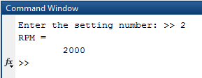
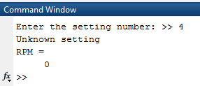
Input function
E.g. Use of input with switch case
Result

Slide 33
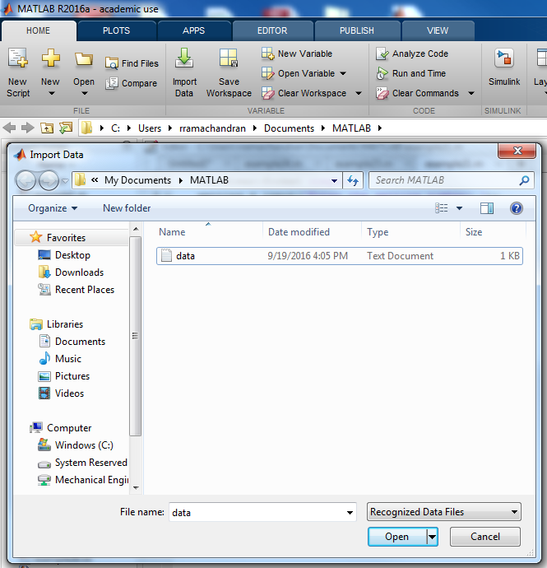
Reading Data from Files
Use the import wizard to determine the data type and to suggest ways to represent the data

Slide 34
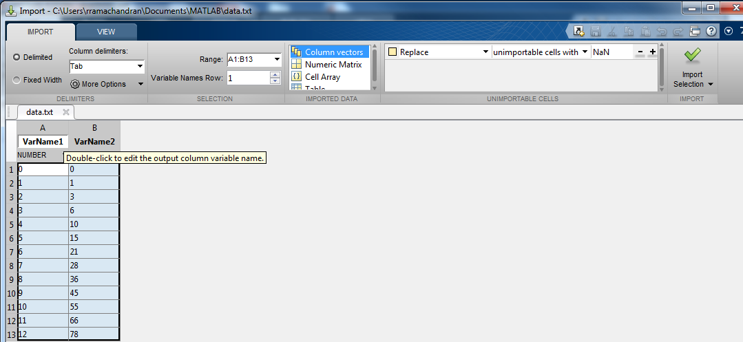
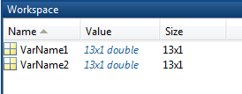
Import Wizard
If the data looks good
Click on the import selection button
Select the data you want to import
The data will appear in the workspace after it has been imported.

Slide 35
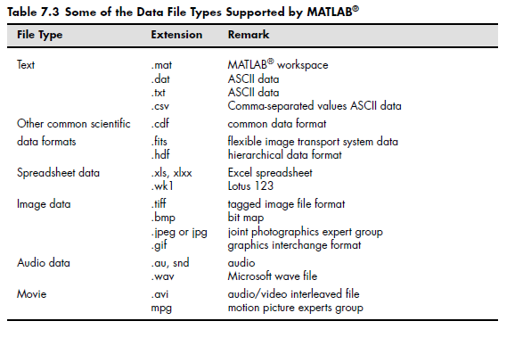

Slide 36
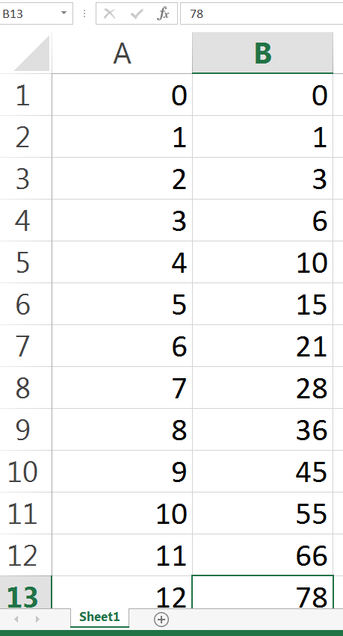
Importing Spreadsheet files
E.g. Import data from the excel file in the location
C:\Users\ashish\desktop\example.xlsx

Slide 37
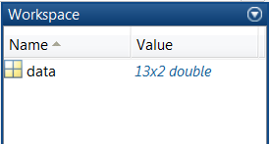
Importing Spreadsheet files
E.g. Import data from the excel file in the location
\\files\users\Austinlopez\Desktop\lec_13.xlsx
Reads only the first worksheet from the file example.xlsx
data=xlsread('\\files\users\Austinlopez\Desktop\lec_13.xlsx');

Slide 38
Importing Spreadsheet files
E.g. Import data from the excel file in the location
Specify the worksheet to read: Sheet1
Specify the range of cells to read: A1 to B13
data = xlsread('c:\Users\...\desktop\example.xlsx'...
,'Sheet1','A1:B13');

Slide 39
Importing Spreadsheet files
E.g. (continued) Assign data to variables and plot the data
data = xlsread('c:\Users\...\desktop\example.xlsx'...
,'Sheet1','A1:B13');
time = data(:,1);
position = data(:,2);
plot(time, position)

